Slide 1


BMC
Business Model Canvas

Slide 2
Business
If you want to be a business.
What would you do?
What will you sell?
Do you have a business plan yet?
A business plan is a plan or method that we adopt to do business.
A business plan is a guideline that you and your employees must adopt in order to execute the plan.
Before starting your business, you should write a business plan.
Businesses that don't have a business plan can have trouble doing business in the future.

Slide 3
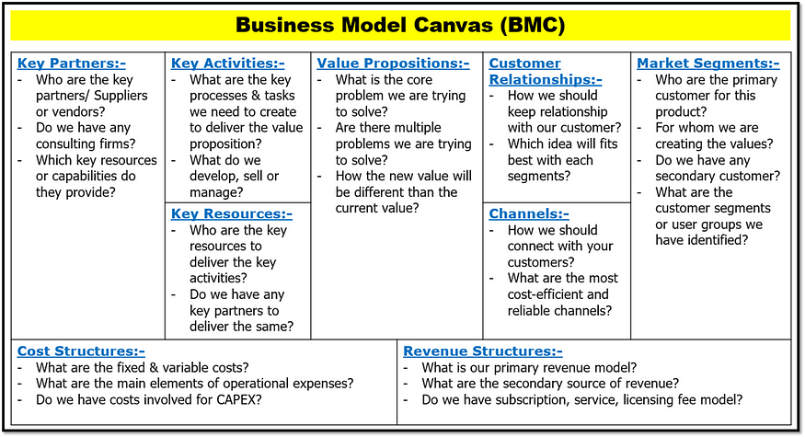

Slide 4
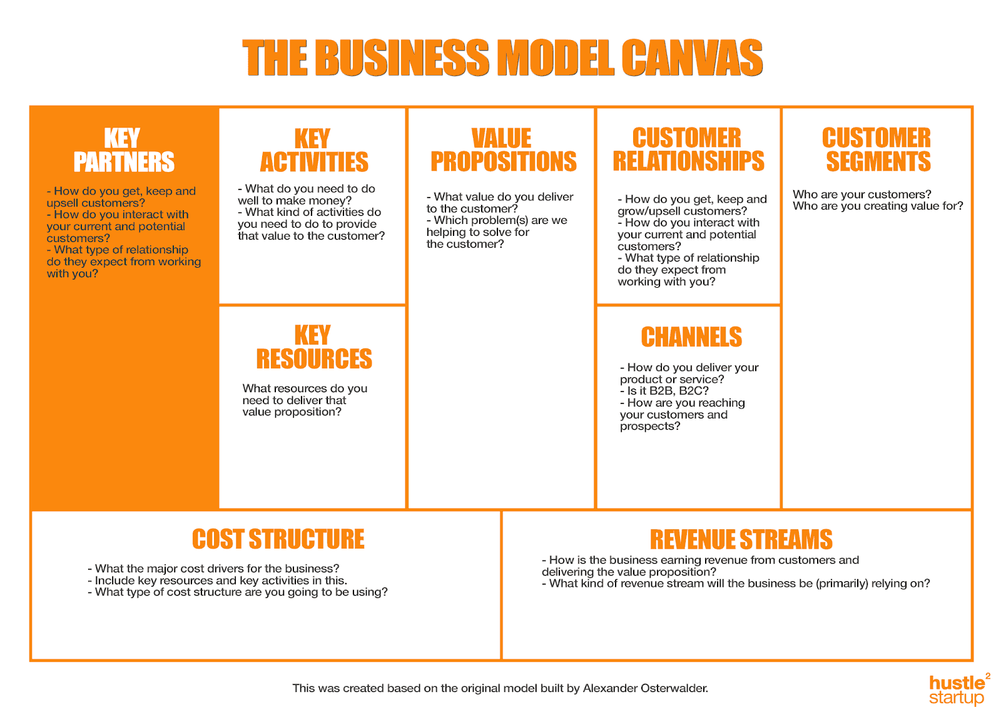

Slide 5
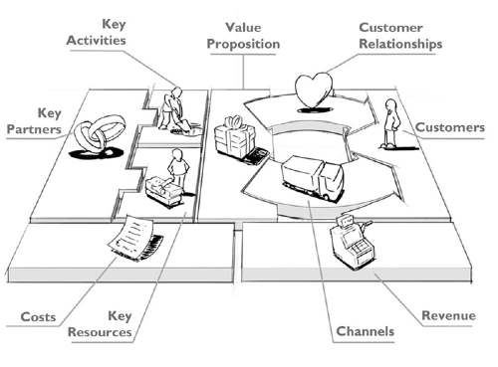

Slide 6
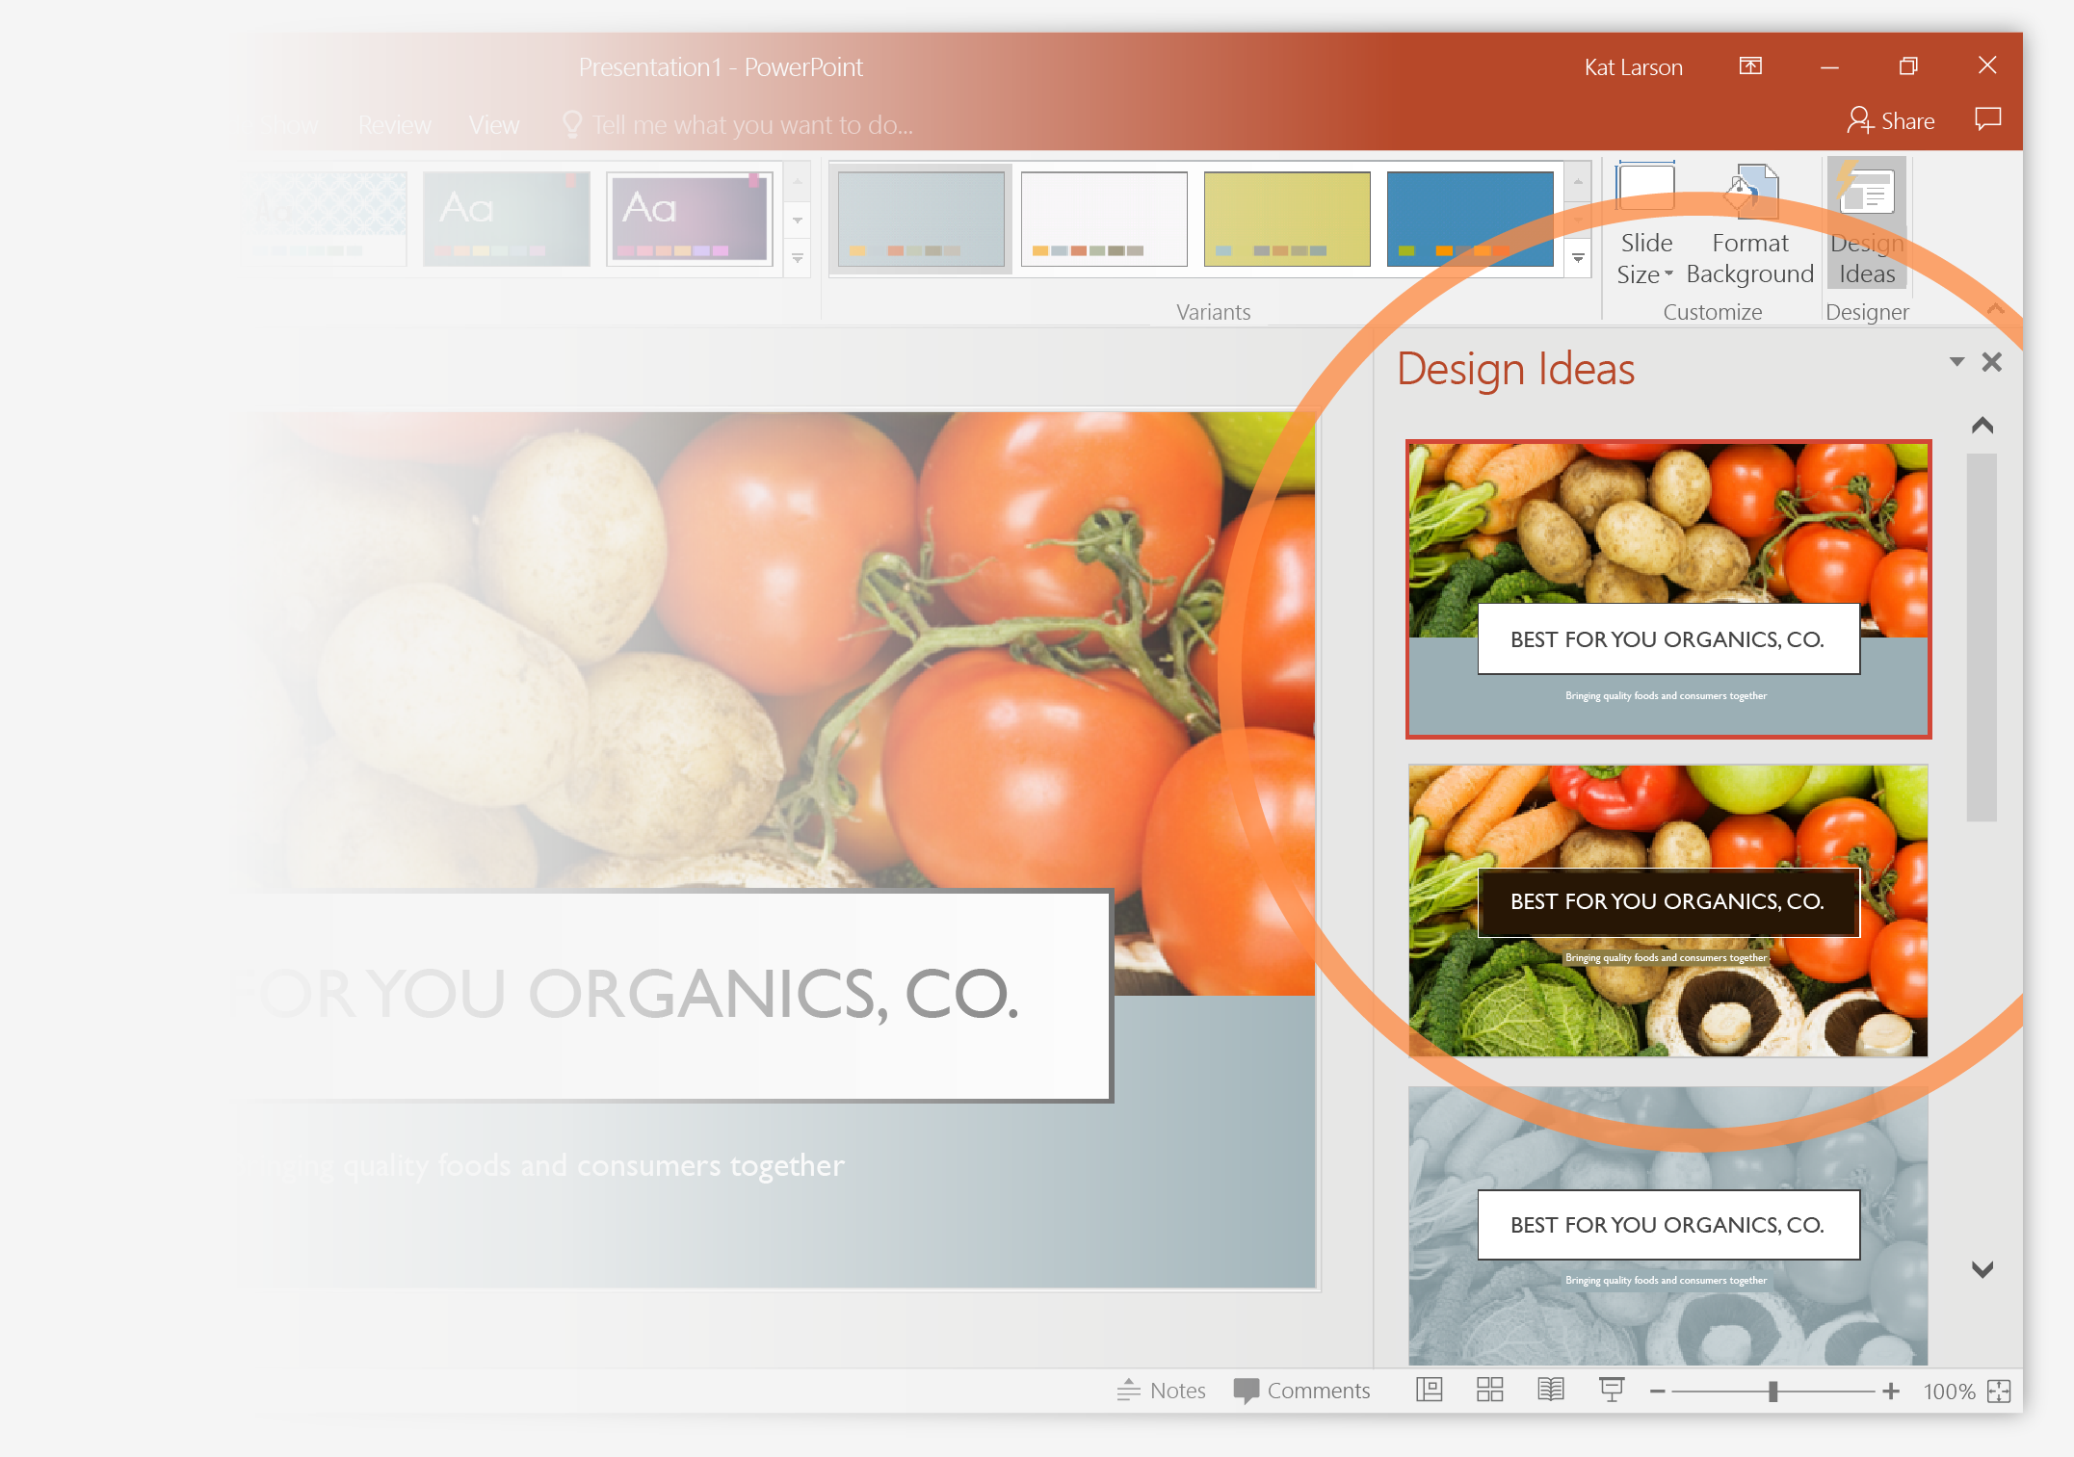
Customer Segments (Customer Groups)
Central to the business model canvas (BMC) is the identification of distinct customer segments, each with its own needs, preferences, and pain points. Customer segmentation in BMC involves dividing a customer base into distinct groups based on shared characteristics such as demographics, interests, and purchasing behaviors. When determining customer segments, it’s crucial to consider who the problem-solvers are, who will perceive value in your offerings, and whether your target audience comprises individuals or businesses. Understanding the characteristics and preferences of your audience, whether they are men or women, young adults, or teenagers, is essential for tailoring your value proposition effectively.
Additionally, assessing the size of each segment helps gain insights into market dynamics at both micro and macro levels. Creating detailed customer personas for each segment provides a deeper understanding of their needs and preferences, facilitating more targeted and effective marketing strategies.

Slide 7
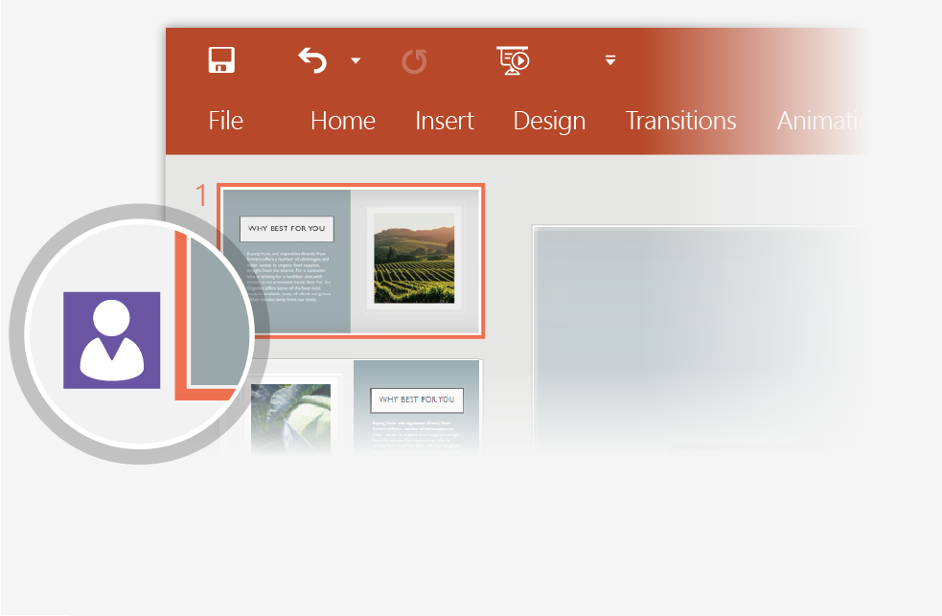
Value Proposition
At the core of the Business Model Canvas lies the value proposition, which encapsulates the unique solution a business offers to address the needs or challenges of a specific customer segment. Whether it’s a product or service, the value proposition should distinguish itself from competitors by being innovative, disruptive, or offering distinctive features. These propositions can be quantitatively defined by factors like price and speed of service, or qualitatively by aspects such as customer experience and design. Crafting a compelling value proposition is essential for attracting and retaining customers, as it communicates the benefits and advantages that set a business apart in the market landscape.

Slide 8

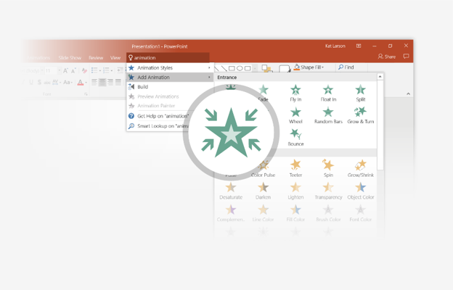
Channels (Customer Channels)
Effective distribution channels are essential for reaching and engaging target customers, and the BMC helps businesses identify and optimize these channels. Identifying the appropriate channels through which to reach your customers is integral to the success of your business. These channels serve as the pathways for customers to discover your value proposition and engage with your offerings. Considerations such as where your customers are located, their media consumption habits, and their online presence are essential in channel selection. For instance, channels could include social media platforms, email marketing, networking events, or traditional advertising mediums like billboards and radio. By understanding how to effectively reach your target audience, businesses can maximize their visibility and engagement, ultimately driving growth and success.
SELECT ME

Slide 9
Customer Relationships
Understanding the nature of your relationship with customers is vital for shaping your business operations effectively. Customer relationships encompass various modes of interaction, from in-person meetings to online engagement. For instance, your business might engage in one-to-one interactions, utilize third-party contractors, or leverage online platforms for customer communication. Creating a User Journey Map can provide valuable insights into these interactions, highlighting touchpoints and opportunities for automation. By delineating the customer relationship landscape, businesses can refine their operations and enhance customer experiences accordingly.

Slide 10
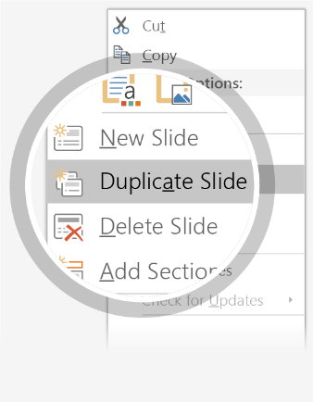
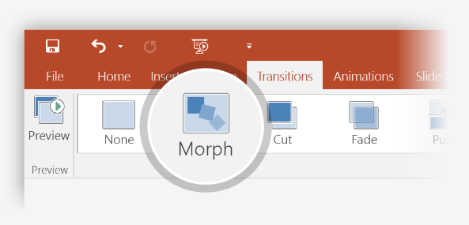

Revenue Streams (Source of Income)
Revenue Streams represent the avenues through which your business monetizes its value proposition, converting solutions to customers’ problems into financial gains. Pricing strategies should align with the perceived value of the solution relative to the customer’s pain point. Various revenue models exist, including pay-per-product, fee-for-service, fixed-rate pricing, subscription models, dividends, referral fees, freemium models, and equity gain opportunities. Selecting the most suitable revenue model hinges on understanding customer preferences, market dynamics, and the unique value proposition offered by the business.

Slide 11
Key Resources
Key resources encompass the assets necessary to create value for customers, ranging from intellectual property to physical infrastructure and human capital. For instance, Zara, a renowned fashion retailer, relies on several key resources to deliver its value propositions effectively. These include robust stock management systems, an extensive network of physical stores, a strong brand presence, and efficient logistics and supply chain infrastructure. Stock availability is crucial for customer satisfaction, and Zara’s distribution network and brand reputation help ensure timely delivery and meet customer demands. Additionally, investing in technology and skilled staff is vital for managing inventory, production processes, and product delivery efficiently.

Slide 12
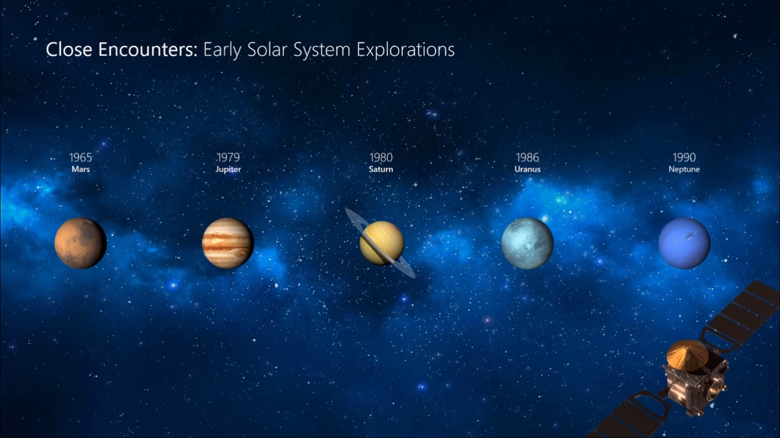
Key Activities
Behind every successful business model is a series of key activities that drive value creation and operational excellence. From product development to marketing campaigns to customer support, identifying and optimizing these core activities is essential for sustained competitiveness. The Key Activities of a business or product are the essential actions taken to fulfil the value proposition for customers. It involves considering the resources, time, expertise, and strategies required to deliver value. For instance, activities could include consulting, designing, web development, baking, driving, or shovelling, depending on the nature of the business. Understanding these activities is crucial for optimizing operations and ensuring the effective delivery of value to customers.

Slide 13

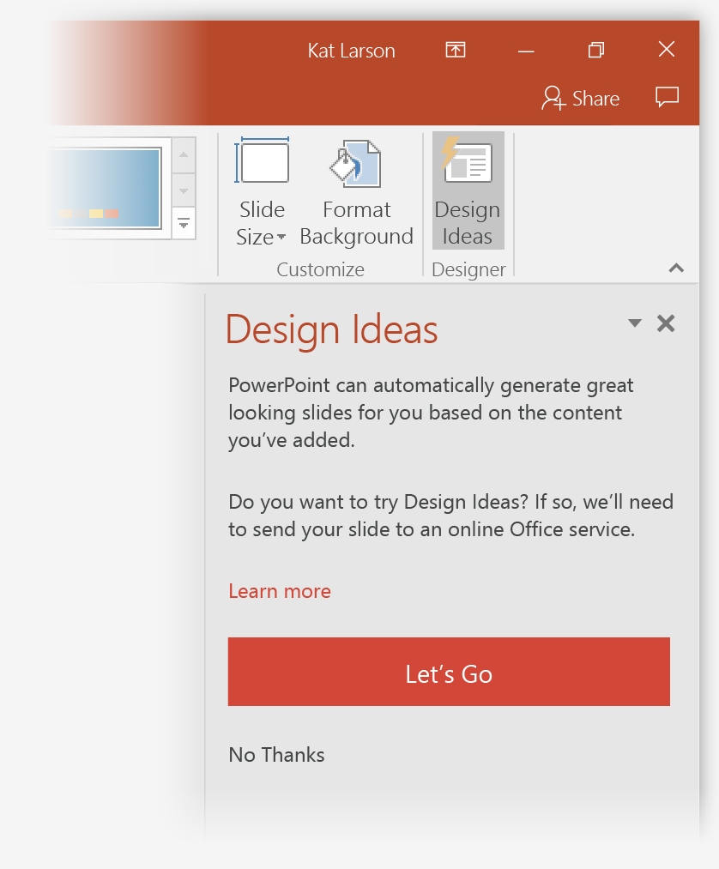
Key Partnerships (Core Partners)
Collaboration lies at the heart of successful business endeavours, and the BMC acknowledges the significance of forging strategic partnerships. Whether through supplier relationships, distribution alliances, or joint ventures, leveraging key partnerships in BMC can unlock new opportunities and enhance value delivery. Identifying the key resources required for your business operations is essential for ensuring the smooth execution of activities. These resources encompass both tangible assets and intangible elements necessary to carry out business functions effectively. Tangible resources may include office space, computers, internet connections, vehicles, machinery, and utilities like electricity. Intangible resources, on the other hand, encompass human capital, such as skilled staff members, expertise, and knowledge. By understanding and securing these resources, businesses can facilitate the seamless execution of key activities and enhance overall operational efficiency.

Slide 14
Cost Structure
The cost structure in BMC of a company encompasses its expenditure on operations and reflects its strategic approach towards costs. A cost-driven company prioritizes minimizing costs to offer competitive prices to customers, as seen in fast-fashion retailers like Forever 21. Conversely, value-driven companies like Gucci emphasize creating value through high-quality products and premium experiences. Understanding key costs, cost drivers, and the relationship between activities, resources, and revenue streams is crucial for optimizing cost structures. Companies also need to assess the balance between fixed and variable costs, leverage economies of scale, and determine whether they prioritize cost optimization or delivering value to customers. Explore resources like CFI’s Budgeting and Forecasting course for insights into effectively managing future cash flows and expenses.

Slide 15
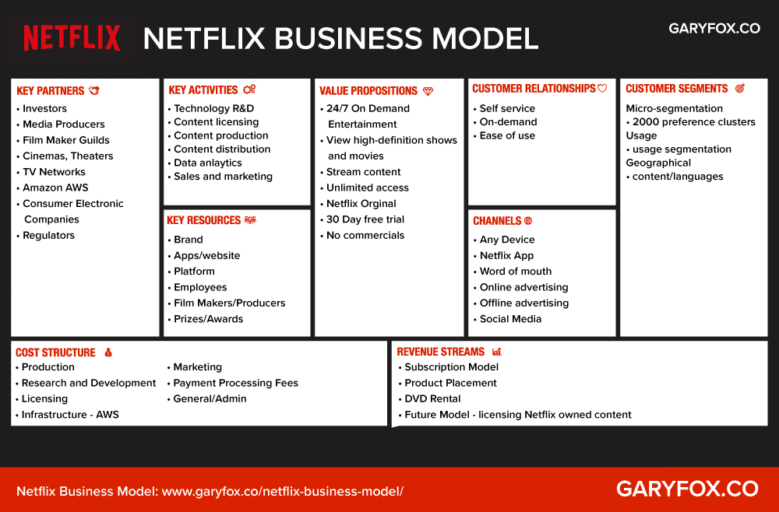

Slide 16
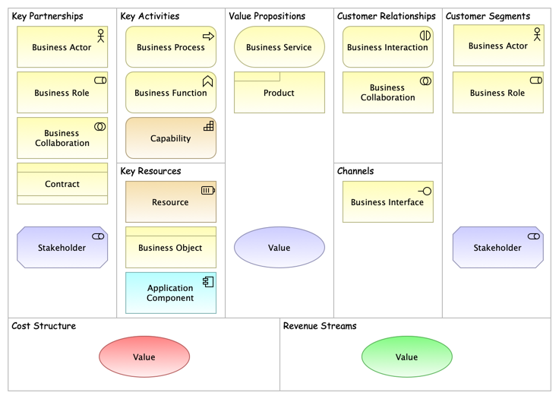

Slide 17
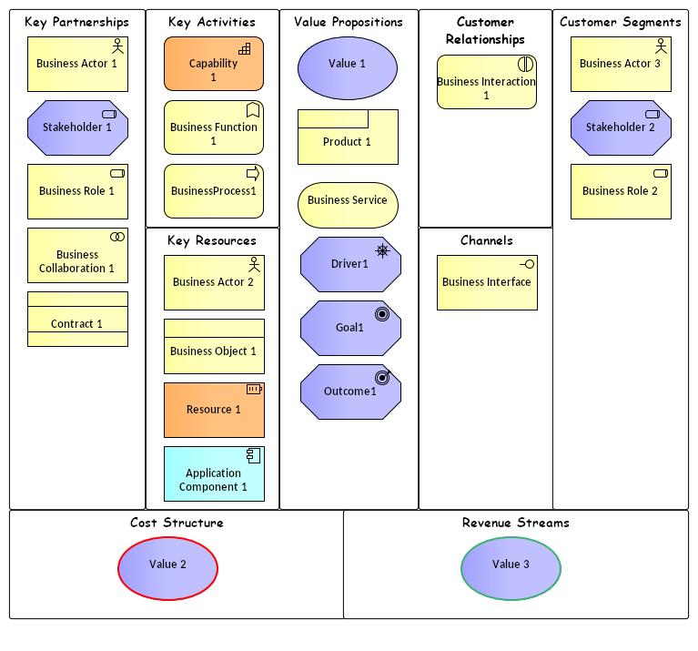

Slide 18
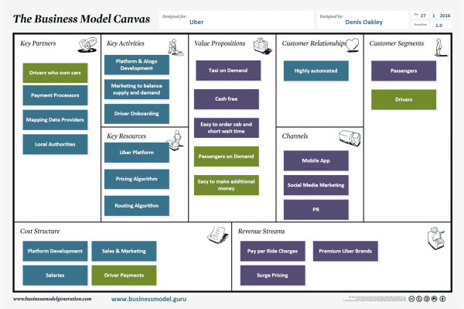

Slide 19
